Slide 1

Title: Breaking the Carbon Curve: Advanced Forecasting of
Global CO2 Emissions Using CNN-GRU
Team Members
1. Lohish – 1DS21CS110
2. Pranav Arya - 150
3. Pranav J S - 152
4. Prudhvi Raj - 160
Under the Guidance of
Prof. Annapoorna B.R
Assistant Professor,
Dept of Computer Science and Engineering
DAYANANDA SAGAR COLLEGE OF ENGINEERING

Slide 2
ABSTRACT
Carbon dioxide emissions are a major concern in the 21st century, contributing to rising global temperatures and climate change.
To tackle this, it's crucial to identify and monitor critical CO2 levels.
The study predicts that by 2047, CO2 levels will reach 500 ppm, a dangerous threshold.
DAYANANDA SAGAR COLLEGE OF ENGINEERING

Slide 3
PROBLEM STATEMENT
Predicting CO2 emissions is tough because so many factors—like economic changes, energy use, and new policies—are constantly shifting. Current models often struggle to keep up, leading to forecasts that aren’t always accurate. Traditional forecasting methods often struggle to capture the complex, non-linear patterns of emission data across sectors and countries.
DAYANANDA SAGAR COLLEGE OF ENGINEERING

Slide 4
LITERATURE SURVEY
SL.NO | TITLE | AUTHORS | YEAR
1 | Predicting future global temperature and greenhouse gas emissions via LSTM model | Ahmad Hamdan, Ahmed Al‑Salaymeh , Issah M. AlHama | 2023
2 | Utilizing time series data from 1961 to 2019 recorded around the world and machine learning to create a Global Temperature Change Prediction Model | Seyed Matin Malakouti | 2023
3 | Forecasting and mitigation of global environmental carbon dioxide emission using machine learning techniques | Harsh Bhatt a , Manan Davawalaa , Tanmay Joshi a , Manan Shah | 2023
4 | A comparative analysis to forecast carbon dioxide emissions | M. O. Faruque, M. A. J. Rabby, M. A. Hossain | 2022
5 | Machine learning based time series models for effective co2 emission prediction in India | K. Singh, S. Kumari | 2022
DAYANANDA SAGAR COLLEGE OF ENGINEERING

Slide 5
LITERATURE SURVEY
SL.NO | TITLE | AUTHORS | YEAR
6 | Forecasting COVID-19 pandemic using Prophet, ARIMA, and hybrid stacked LSTM-GRU models in India | S. Sah, B. Surendiran, R. Dhanalakshmi | 2022
7 | Time-series analysis with smoothed convolutional neural network | A. P. Wibawa, A. B. P. Utama, H. Elmunsyah | 2022
8 | Research on carbon emission prediction and economic policy based on TCN-LSTM combined with attention mechanism | X. Wei and Y. Xu | 2023
DAYANANDA SAGAR COLLEGE OF ENGINEERING

Slide 6
BASE PAPER
Comparative Analysis to Forecast Carbon Dioxide Emissions - Md. Omer Faruque, published on 28 June 2022
Problem Statement -
Despite increasing awareness and commitment to climate change, global CO2 emissions are rising dramatically. The energy sector’s CO2 emissions are a critical concern for all countries. Accurate forecasting of CO2 emissions is crucial for addressing climate change and its impacts. The paper aims to forecast CO2 emissions using various deep learning models and methods.
DAYANANDA SAGAR COLLEGE OF ENGINEERING

Slide 7
BASE PAPER
2. Methodology
Examines CO2 emissions, electrical energy consumption, and GDP in Bangladesh from 1972 to 2019.
Forecasting Models:
Convolutional Neural Network (CNN)CNN with Long Short-Term Memory (CNN-LSTM)Long Short-Term Memory (LSTM) Dense Neural Network (DNN)
Regression Metrics Used: Root Mean Square Error (RMSE)Mean Absolute Error (MAE)Mean Absolute Percentage Error (MAPE)
DAYANANDA SAGAR COLLEGE OF ENGINEERING

Slide 8
BASE PAPER
3. Results-
Model Performance:
CNN: MAPE = 15.043
CNN-LSTM: MAPE = 5.065
LSTM: MAPE = 5.377
DNN: MAPE = 3.678
Best Performing Model : DNN showed the highest accuracy compared to other models based on evaluation metrics.
DAYANANDA SAGAR COLLEGE OF ENGINEERING

Slide 9
BASE PAPER
4.Gaps and Further Research-
Parameter Optimization: The study did not use advanced hyperparameter optimization techniques, which could improve model performance.
Additional Techniques: Future research could explore other methods for forecasting and analysis, including different models.
Broader Implications: Emphasizes the need for Bangladesh to improve CO2 emissions forecasting and adjust climate and energy policies, considering the country's industrial growth and population dynamics.
DAYANANDA SAGAR COLLEGE OF ENGINEERING

Slide 10
OBJECTIVE
A novel approach to forecasting CO2 emissions by using multivariate time-series analysis and considering various factors such as country, sector and population.
Using a powerful combination of CNN and GRU models to achieve more accurate predictions of global emissions trends, ultimately helping to shape better climate policies and decisions.
DAYANANDA SAGAR COLLEGE OF ENGINEERING

Slide 11
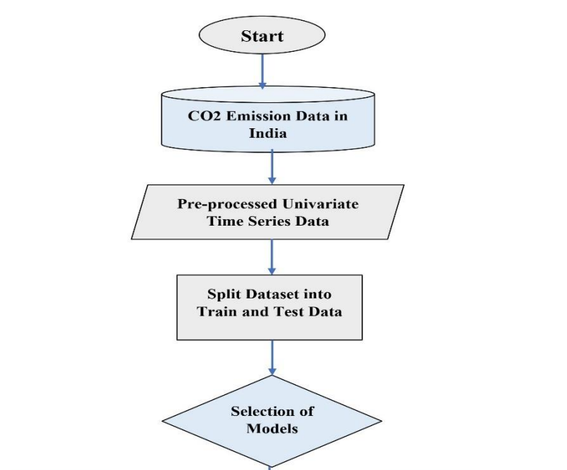
ARCHITECTURE STATE DIAGRAM
ARIMA
LSTM
CNN-LSTM
CNN & GRU
DAYANANDA SAGAR COLLEGE OF ENGINEERING

Slide 12
PROPOSED MODELS
ARIMA
Best for univariate time series with linear trends and seasonality. Use ARIMA as a baseline model for comparison to assess the complexity of CO2 emissions trends.
2. LSTM
Recurrent Neural Network (RNN) variant that captures long-term dependencies in sequential data. Ideal for time-series data with complex, non-linear patterns. Use LSTM to detect patterns in CO2 emissions across sectors and countries.
DAYANANDA SAGAR COLLEGE OF ENGINEERING

Slide 13
PROPOSED MODELS
3. CNN-LSTM
Combines CNN layers for feature extraction and LSTM layers for handling sequences. Useful for capturing both local and sequential patterns. Apply LSTM-CNN to extract features from CO2 emissions data for forecasting.
4. CNN-GRU
Hybrid model where CNNs extract features and GRUs handle sequences. GRUs offer a simpler alternative to LSTMs with similar effectiveness. Use CNN-GRU to extract spatial-temporal features from multi-dimensional emissions data.
DAYANANDA SAGAR COLLEGE OF ENGINEERING

Slide 14
DATA ANALYSIS
1. Sector-Specific Emission Trends Objective: Identify which sectors (Power, Industry, Transport, etc.) contribute most to emissions in each country and how these patterns evolve over time.
2. Cross-Sectoral Interactions and Correlations Objective: Explore how emissions from different sectors are interrelated, identifying whether changes in one sector influence emissions in another.
3. Country-Level Comparative Analysis Objective: Compare CO2 emissions between countries, highlighting differences in emission trajectories and growth rates.
4. International vs. Domestic Emission Patterns Objective: Compare emissions from domestic and international aviation, particularly in response to travel restrictions and changes in behavior.
5. Global Emission Contributions and Anomalies Objective: Analyze each country’s contribution to global emissions, highlighting any anomalies or shifts in emission patterns
DAYANANDA SAGAR COLLEGE OF ENGINEERING

Slide 15
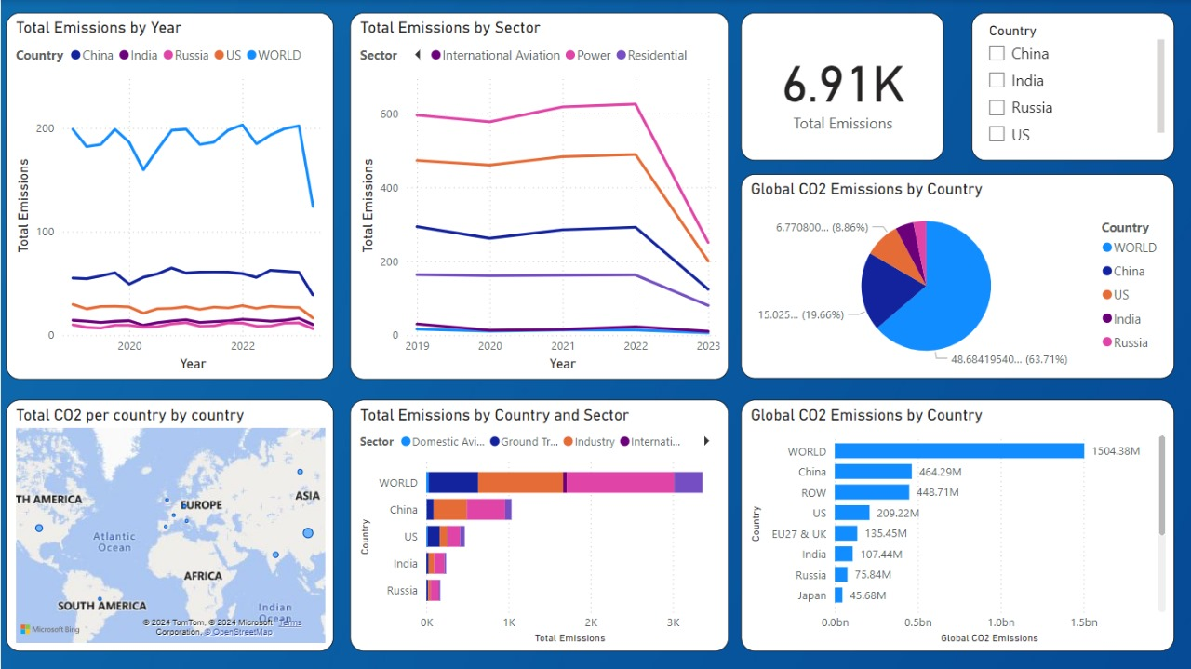
DATA ANALYSIS
DAYANANDA SAGAR COLLEGE OF ENGINEERING

Slide 16
APPLICATIONS
Direct Focus:
Real-Time Emission Forecasting for Operational Decisions – Ability to forecast co2 emissions with high accuracy.
2. Enhanced Environmental Compliance Monitoring – Improves environmental conditions.
3. Shaping Climate Policies - Help to set goals to reduce co2 emissions.
DAYANANDA SAGAR COLLEGE OF ENGINEERING

Slide 17
APPLICATIONS
Long-Term Focus:
1. Sustainable Product Development – Helps to develop sustainable products.
2.Guiding Urban Development – Uses to make decisions about traffic and create green spaces.
3.Supporting Corporate Sustainability – To predict how different strategies impact co2 output.
DAYANANDA SAGAR COLLEGE OF ENGINEERING

Slide 18
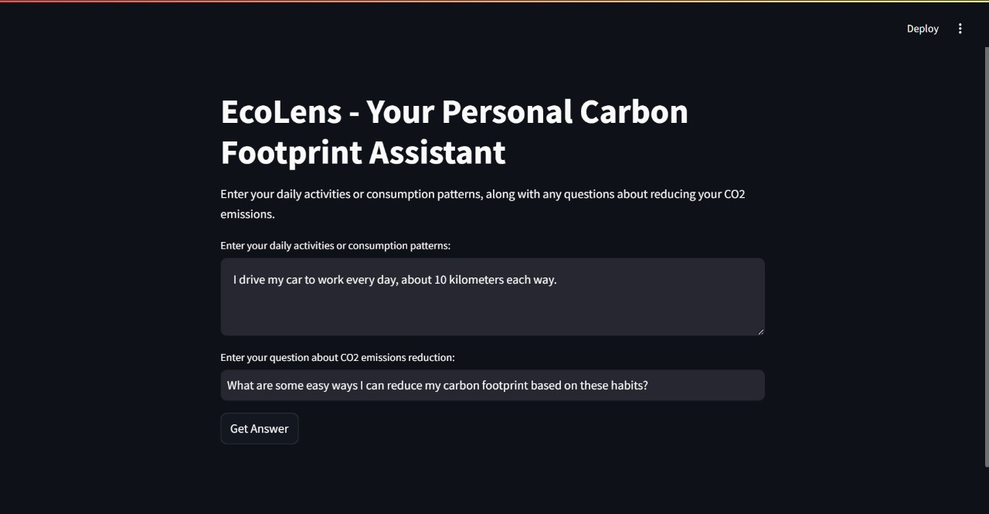
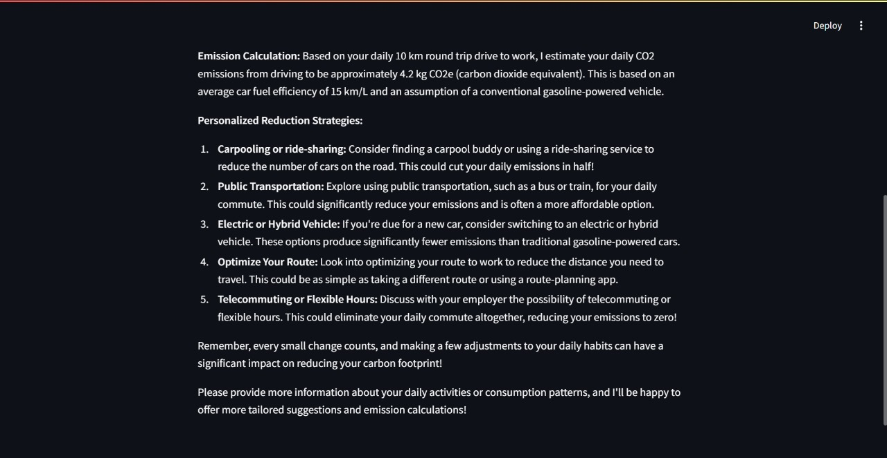
ECOLENS
DAYANANDA SAGAR COLLEGE OF ENGINEERING

Slide 19
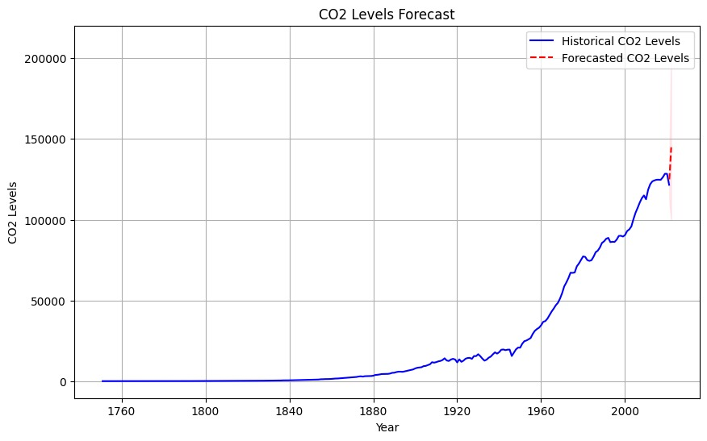
RESULTS
DAYANANDA SAGAR COLLEGE OF ENGINEERING

Slide 20
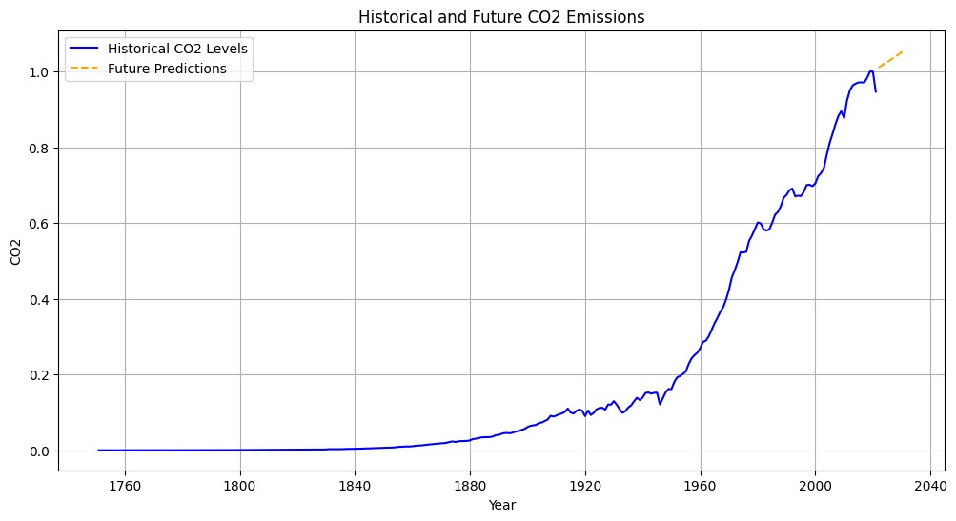
RESULTS
DAYANANDA SAGAR COLLEGE OF ENGINEERING

Slide 21
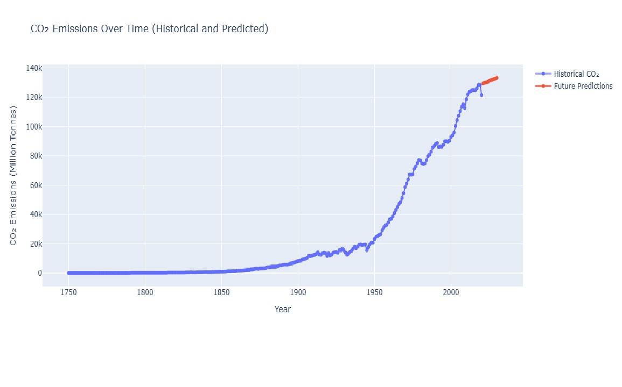
RESULTS
DAYANANDA SAGAR COLLEGE OF ENGINEERING

Slide 22
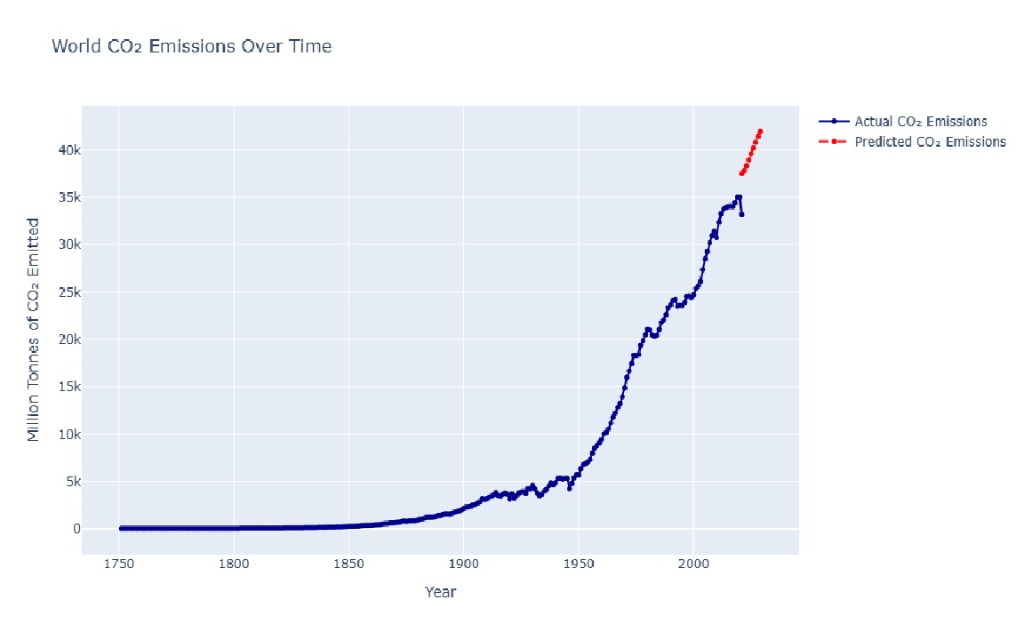
RESULTS
DAYANANDA SAGAR COLLEGE OF ENGINEERING

